Slide 1
Nevada Connections Academy
NSPF Improvement Roadmap
Dr. Chris McBride
Superintendent, NCA

Slide 2
Roadmap Presentation Components
Overall Areas of Focus
Framework Overview
Academic Achievement
Graduation Rates
College & Career Readiness
Student Engagement

Slide 3
Overall Areas of Focus/Culture Shift
EVERY STUDENT WILL BE PLACED IN A TRACK TO GRADUATE COLLEGE & CAREER READY
EVERY NCA TEACHER WILL MONITOR HOW EACH STUDENT IMPACTS THE NSPF
COURSEWORK WILL BE SUPPLEMENTED WITH ACT-BASED TESTING SKILLS
COURSE COMPLETION, INTERVENTION AND CREDIT ACCRUAL WILL BE AREAS OF FOCUS
STUDENT ENGAGEMEMT WILL BE MONITORED DAILY AND OWNED BY EVERY SCHOOL EMPLOYEE
INDIVIDUALIZED PLANS WILL BE IMPLEMENTED AND REVIEWED TO MATCH STUDENT INTERESTS

Slide 4
NSPF Overview
INDICATOR | Total Possible | NCA 20/21 Target | NCA 21/22 Target
Academic Achievement | 20 ACT 5 Science | 7 ACT 3 Science | 8 ACT 3 Science
Graduation Rate (4yr) | 25 | 11 (78.2% in 19/20) | 16 (83%)
Graduation Rate (5yr) | 5 | 1 (69%) | 2 (78.7%)
English Language Proficiency | N/A | N/A | N/A
College & Career Readiness | 25 | 7.5 | 12
Student Engagement | 10 | 7 | 7
TOTAL | 90 | 36.5 | 48
Converted to 100 point scale |  | 40.6 2-star | 53.3 3-star
Notes:
19/20- Achievement- 6.5 (5 and 1.5); student engagement 4; grad rate 0; CCR 2 = 13.8

Slide 5
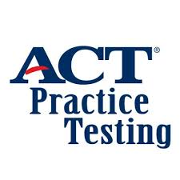
Academic Achievement
Complete ACT-based focus
Subject-specific alignment to ACT, Science, EOC Exams
Online ACT Practice Tests for all students
Response to Intervention Program (RtI)

Slide 6
Academic Achievement
CCR Placement Sessions
New Student Enrollment Calls
Academic Probation
Department and Grade Level Professional Learning Communities
ACT Instructional Training for All Teachers
Progress Monitoring and Formative Benchmarking

Slide 7
Academic Achievement – Understanding Escalation
What is Escalation?
Escalation is the system Nevada Connections Academy uses to monitor student progress, attendance, and performance. It is monitored weekly.
The three stages of escalation are On-Track, Approaching Alarm and Alarm.

Slide 8
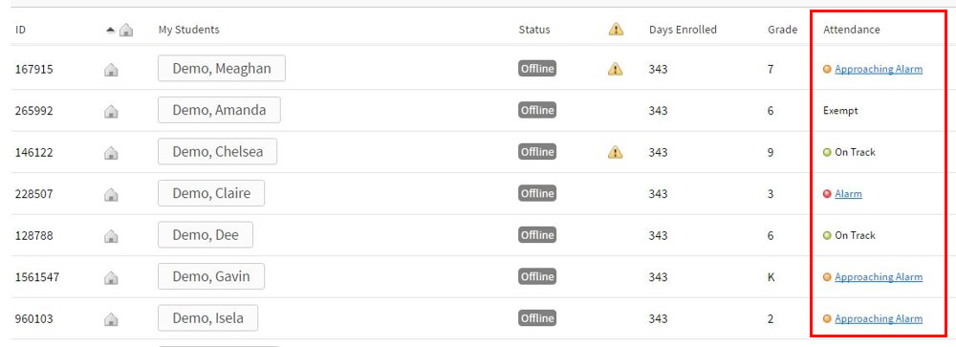
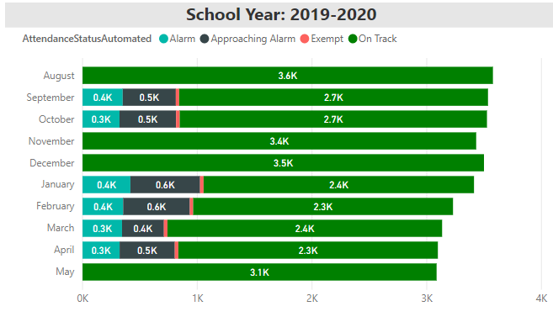
Academic Achievement – Understanding Escalation

Slide 9
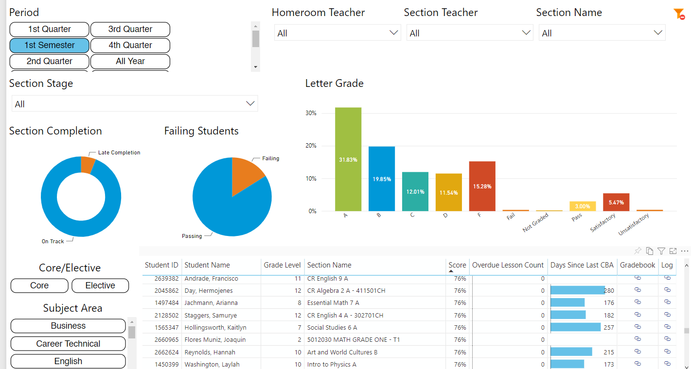
Academic Achievement – Student Performance

Slide 10
Graduation Rates – Rainbow List
The Rainbow List Protocol (RLP) is an excellent way for Nevada Connections Academy to monitor and support all students who have enrolled and to improve the school’s graduation rate.
The RLP contains two main categories of color lists: Enrolled Students (green, yellow, red) and Withdrawn Students (blue, pink black).
Enrolled Students:
GREEN - On-Track (EOT)
YELLOW - Off-Track Yellow - 3 or less credits behind (EOTY)
RED - Off-Track Red - 3.5+ credits behind (EOTR)
Withdrawn Students:
BLUE - Transfer Pending (WTP)
PINK - Status Unknown (WSU)
BLACK - Confirmed Dropout (WCD)

Slide 11
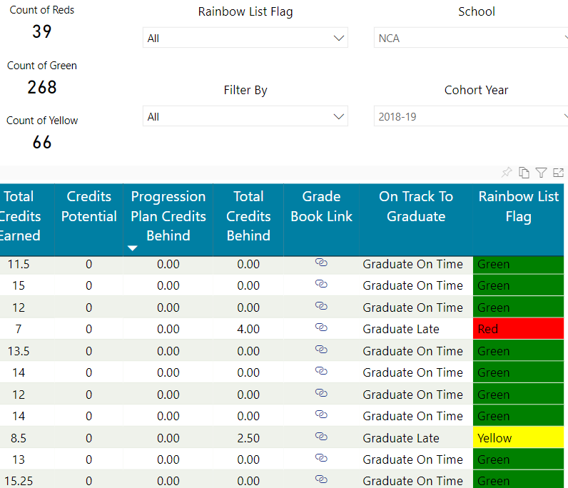
Graduation Rates – Rainbow List

Slide 12
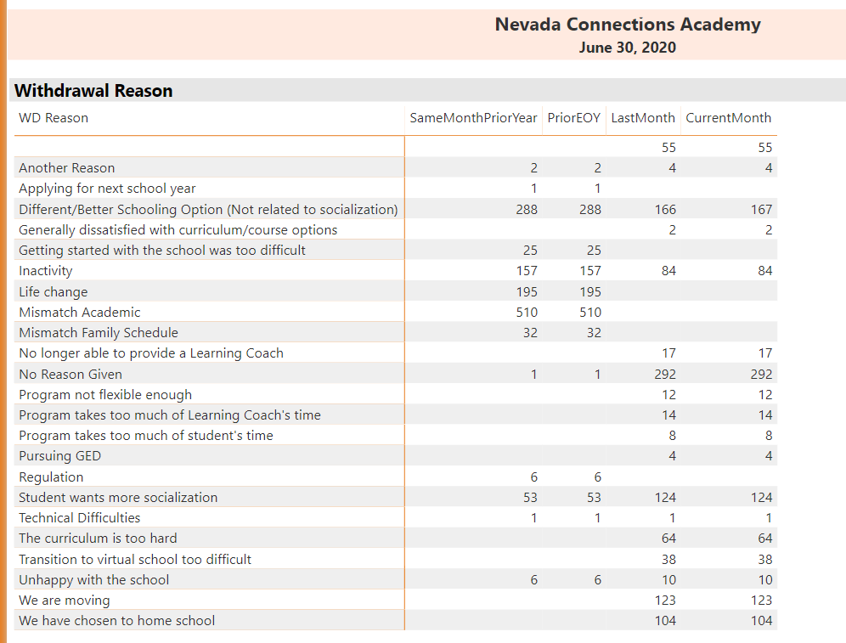
Tracking Withdrawal Reasons

Slide 13
College & Career Readiness

Slide 14
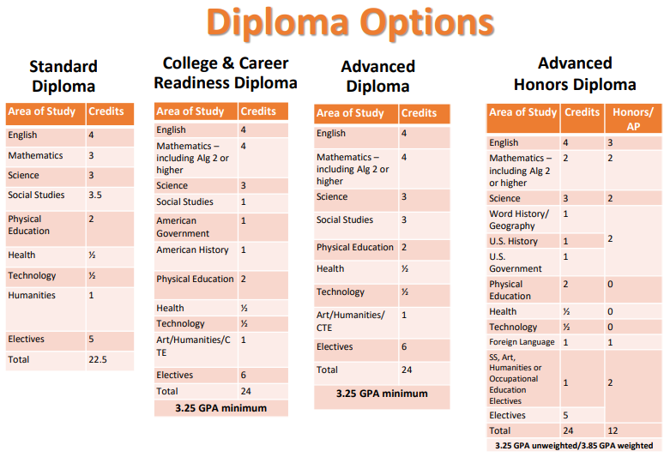
College & Career Readiness

Slide 15
College & Career Readiness

Slide 16
What will Nevada Connections Board Monitor Quarterly?
Quarterly Metric Reports are provided to the NCA Board with metrics on the following components:
Graduation Rates:
Student on track to graduate
Credit recovery efforts for students
9th Grade Sufficiency
Chronic Absenteeism (monitored weekly)
Pass Rate\Course Completion (monitored weekly)
ACT Prep efforts
CCR Enrollments
Student Engagement Metrics (monitored weekly)
Renaissance Benchmark Assessment Data (3x/year)

Slide 17
Student Engagement
Quarterly Metric Reports are provided to the NCA Board with updates on contacts, chronic absenteeism, sufficiency and attendance.

Slide 18
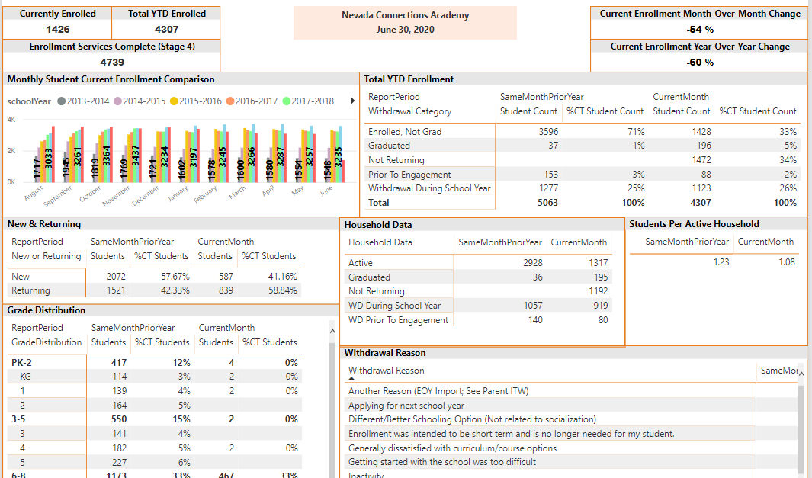
Additional Reporting

Slide 19
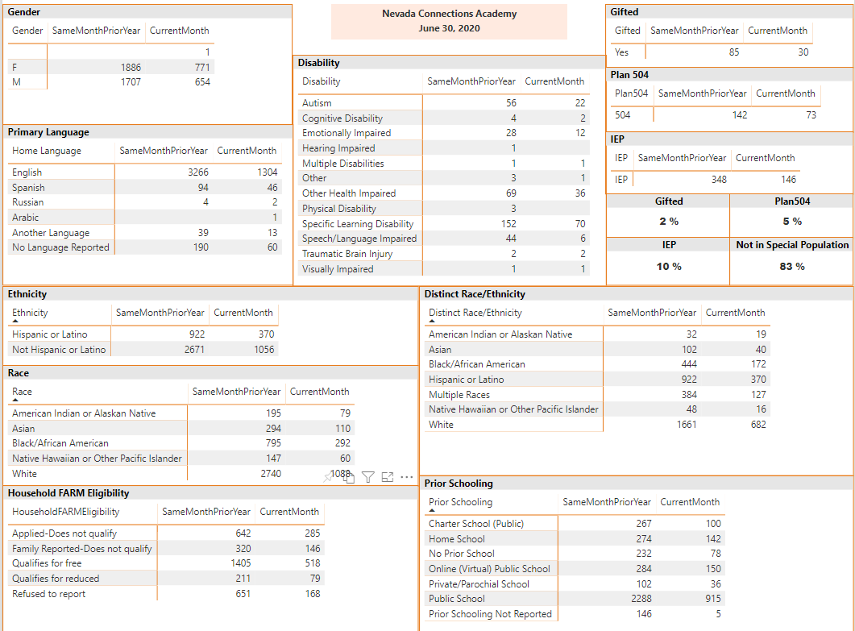
Additional Reporting

Slide 20
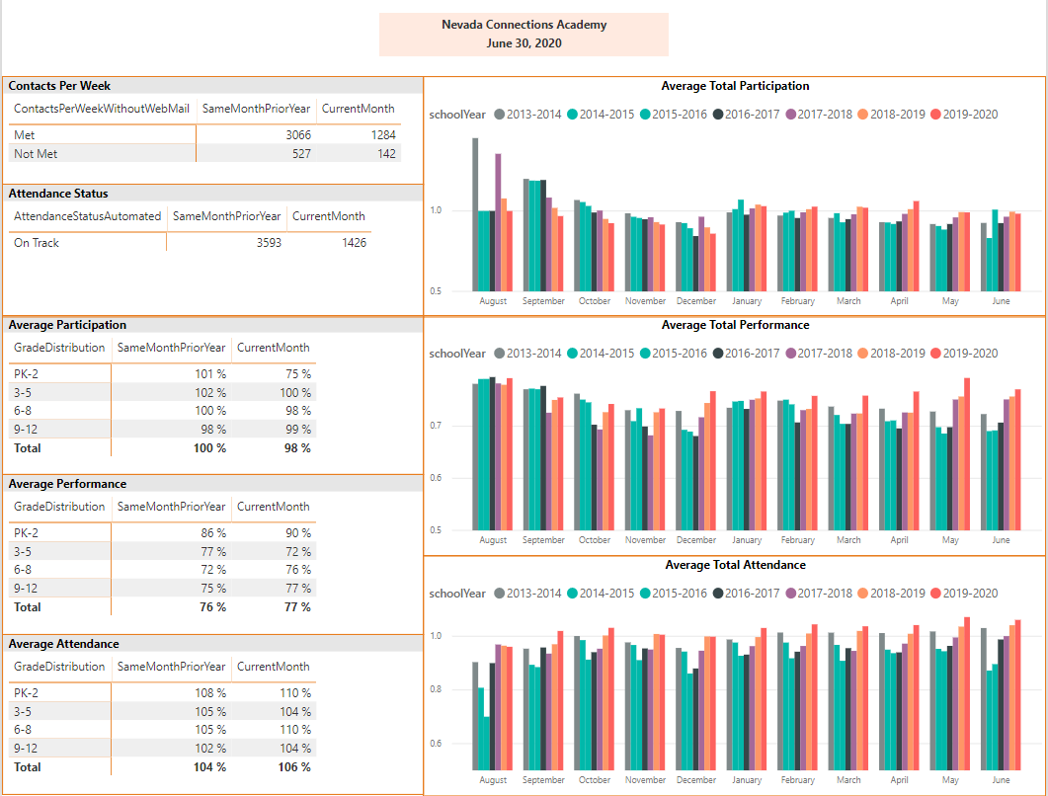
Additional Reporting

Slide 21
Additional Student Supports
Review contact and grade (escalation) distribution data weekly and quarterly for targeted staff conversations/support
Benchmark data (Fall, Winter, Spring)- implement strategies derived from PLC group discussions
Targeted PD depending on student need including on Diversity/Inclusion, SEL, data analysis and response, RtI, etc.

